Slide 1
Data warehouse design

Slide 2
Methodological Framework
Building a DW is a very complex task
It requires an accurate planning aimed at devising satisfactory answers to organizational and architectural questions
A large number of organizations lack experience and skills that are required to meet the challenges involved in DW projects
Reports of DW project failures state that a major cause lies in the absence of a global view of the design process,
i.e., absence of a design methodology

Slide 3
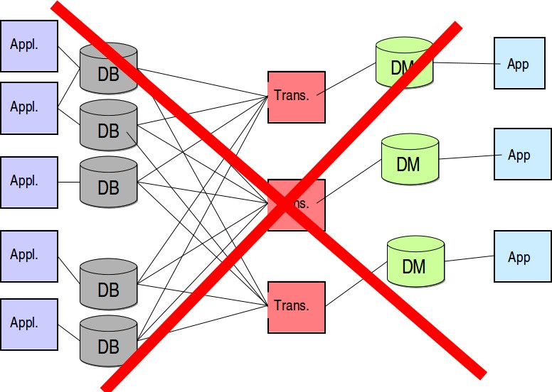
Many Ways not to Do

Slide 4
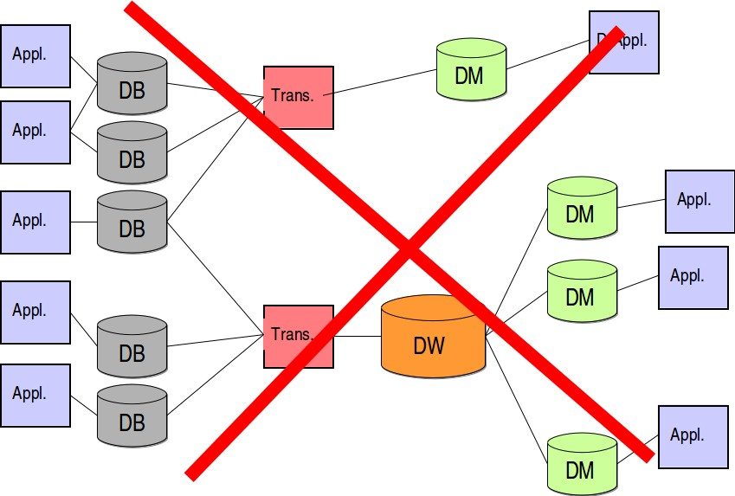
Many Ways not to Do

Slide 5
Top-Down Approach
Top-down approach: Analyze global business needs, plan how to develop a data warehouse, design it, and implement it as a whole
Looks promising as it is based on a global picture of the goal to achieve, and in principle it ensures consistent, well integrated DW
High cost estimates with long-term implementations discourage company managers
Analyzing/integrating all relevant sources at the same time is a very difficult task, even because it is not very likely that they are all available and stable at the same time.
It is extremely difficult to forecast the specific needs of every department, which can result in the analysis process coming to a standstill.
Since no working system is delivered in the short term, users cannot check for this project to be useful, so they lose trust and interest in it.

Slide 6
Bottom-Up Approach
Bottom-up approach: DW is incrementally built by iteratively creating several data marts
Each data mart is based on a set of facts that are linked to a specific department and that can be interesting for a user group
Leads to concrete results in a short time Does not require huge investments
Enables designers to investigate one area at a time
Gives managers a quick feedback about the actual benefits of the system being built
Keeps the interest for the project constantly high May determine a partial vision of the business domain

Slide 7
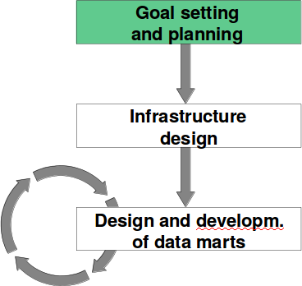
The Life-cycle – Goal Setting and Planning
Set system goals, borders, and size
Select an approach for design and implementation
Estimate costs and benefits Analyze risks and expectations
Examine the skills of the working team

Slide 8
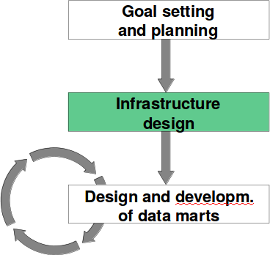
The Life-cycle – Infrastructure Design
Analyze and compare the possible architectural solutions
Assess the available technologies and tools
Create a preliminary plan of the whole system

Slide 9
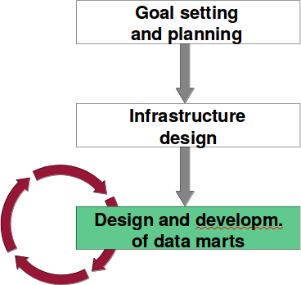
The Life-cycle – Design and Development of DMs
Every iteration causes a new DM and new applications to be created and progressively added to the DW system.

Slide 10
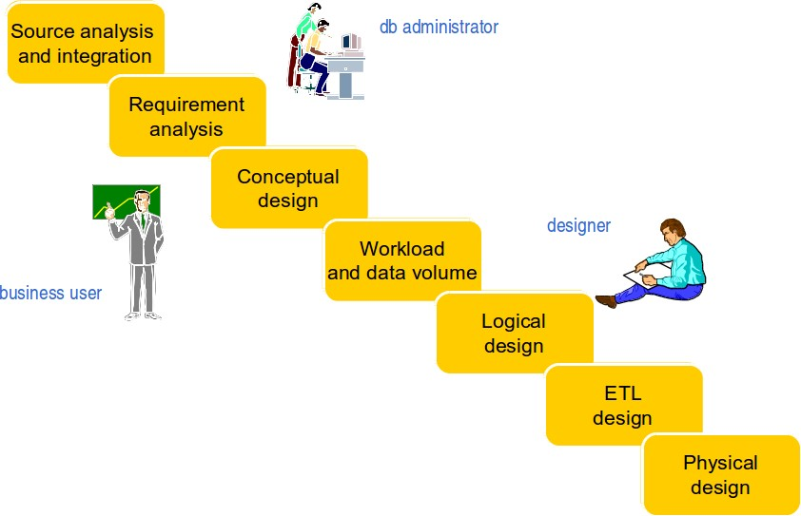
Data Mart Design Phases

Slide 11
Different Approaches for DM Design
Supply-driven (data-driven) approach
Demand-driven (requirement-driven) approach Mixed approach

Slide 12
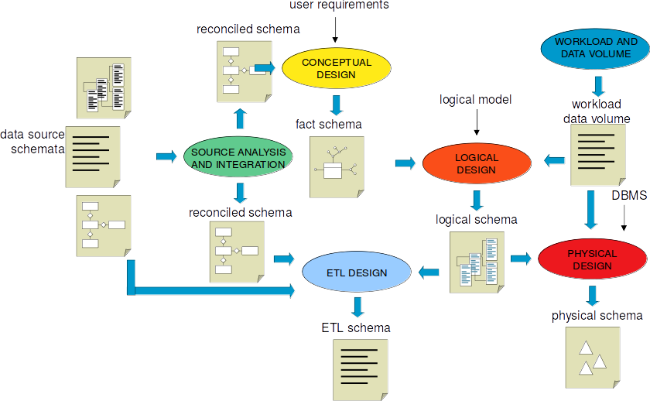
Supply-driven (Data-driven) DM Design

Slide 13
Supply-driven (Data-driven) DM Design
Approach
Begin with an analysis of the data sources
User requirements show designers which groups of data should be selected
Pros
Initial conceptual schema for DMs can be automatically derived from the reconciled layer
ETL design is extremely streamlined because every single information piece in a DM is directly associated with source attributes
Resulting DMs are stable in time since they are rooted in source schemata In general, project goals can be reached in a short time
Cons
User requirements play a minor role when specifying the contents Designers have a limited support during the specification of facts, dimensions, and measures

Slide 14
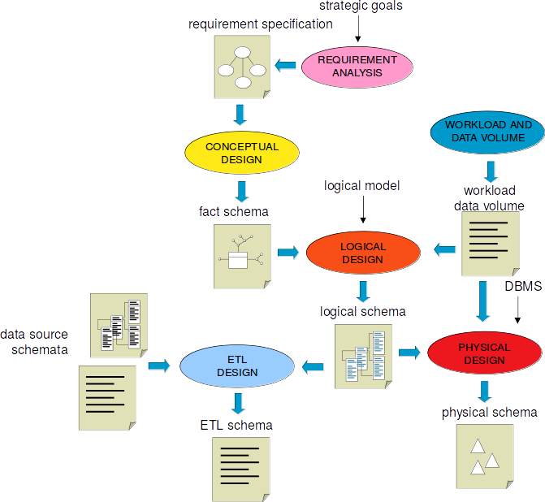
Demand-driven (Requirement-driven) DM Design

Slide 15
Demand-driven (Requirement-driven) DM Design
Approach
Begin with the definition of information requirements of DM users
The problem of how to map those requirements into existing data sources is addressed at a later stage
Pros
User requirements play a leading role
Cons
Designers need strong leadership and mediation qualities to properly integrate different viewpoints
Required data might not be available in data sources
In general more time intensive since users do not have a clear understanding of the business goals

Slide 16
Mixed Approach to DM Design
Requirement and data source analysis are done at the same time
→ user requirements
→ reconciled layer
User requirements help to reduce the complexity of the reconciled layer Mixed approach is typically the best solution

Slide 17
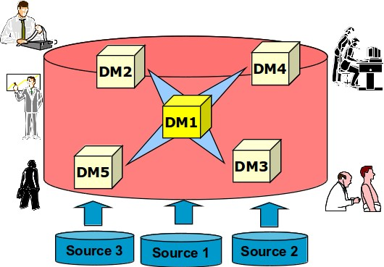
The First Data Mart
Is the one playing the most strategic role for the enterprise Should be a backbone for the whole DW
Should lean on available and consistent data sources

Slide 18
Business Dimensional Lifecycle
(Kimball)
Planning
Requirement definition
Architecture design
Dimensional modeling
APPLICATIONS
User Application Analysis
Project management
Product selection and installation
Physiscal design
DATA
TECHNOLOGY
Feeding design and implementation
User Application Development
Deployment
Maintenance

Slide 19
Requirement analysis

Slide 20
Requirement analysis
It collects
data analysis requirements to be supported by the data mart
implementation constraints due to existing information systems
Requirement sources
business users
operational system administrators
The first selected data mart is
crucial for the company
feeded by (few) reliable sources

Slide 21
Application requirements
Description of relevant events (facts)
each fact represents a category of events which are relevant for the company
examples: (in the CRM domain) complaints, services
characterized by descriptive dimensions (setting the granularity), history span, relevant measures
informations are gathered in a glossary
Workload description
periodical business reports
queries expressed in natural language
example: number of complaints for each product in the last month

Slide 22
Structural requirements
Feeding periodicity
Available space for
data
derived data (indices, materialized views)
System architecture
dependent or independent data marts
Deployment planning
start up
training

Slide 23
Conceptual design

Slide 24
Conceptual design
No currently adopted modeling formalism
ER model not adequate
Dimensional Fact Model (Golfarelli, Rizzi)
graphical model supporting conceptual design
for a given fact, it defines a fact schema modelling
dimensions
hierarchies
measures
it provides design documentation both for requirement review with users, and after deployment

Slide 25
Dimensional Fact Model
Fact
it models a set of relevant events (sales, shippings, complaints)
it evolves with time
Dimension
it describes the analysis coordinates of a fact (e.g., each sale is described by the sale date, the shop and the sold product)
it is characterized by many, typically categorical, attributes
Measure
it describes a numerical property of a fact (e.g., each sale is characterized by a sold quantity)
aggregates are frequently performed on measures
product
fact
dimension
SALE
date
shop
sold quantity sale amount
number of customers unit price

Slide 26
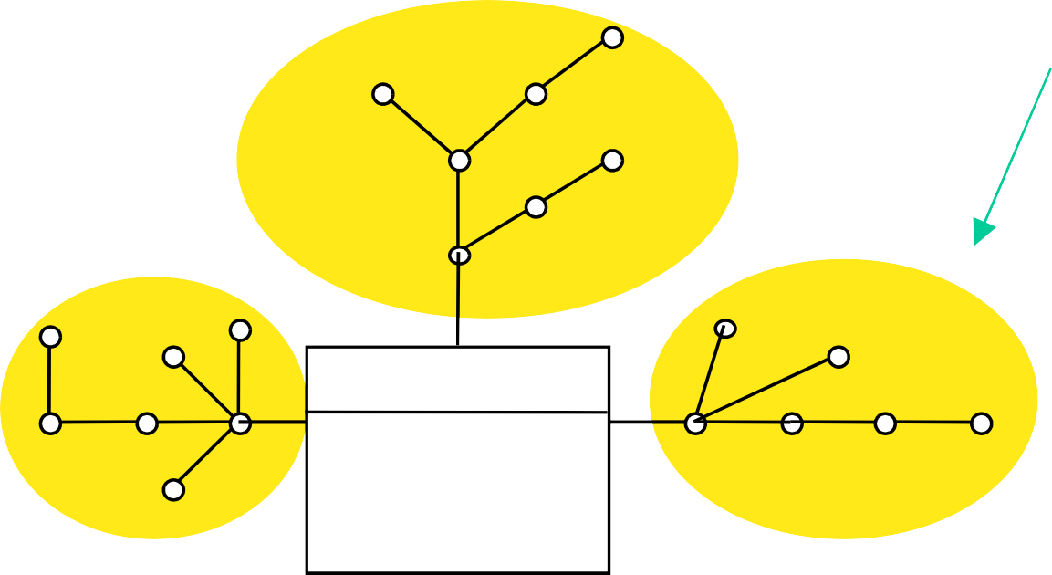
DFM: Hierarchy
Each dimension can have a set of associated attributes
The attributes describe the dimension at different abstraction levels and can be structured as a hierarchy
The hierarchy represents a generalization relationship among a subset of attributes in a dimension (e.g., geografic hierarchy for the shop dimension)
The hierarchy represents a functional dependency (1:n relationship)
dimension attribute
marketing group
department
category
type
brand city
brand
hierarchy
product
year
day
sale manager
sale district
holiday
From Golfarelli, Rizzi
date
SALE
sold quantity sale amount
number of customers unit price
shop
quarter
month
shop city
region country
week

Slide 27
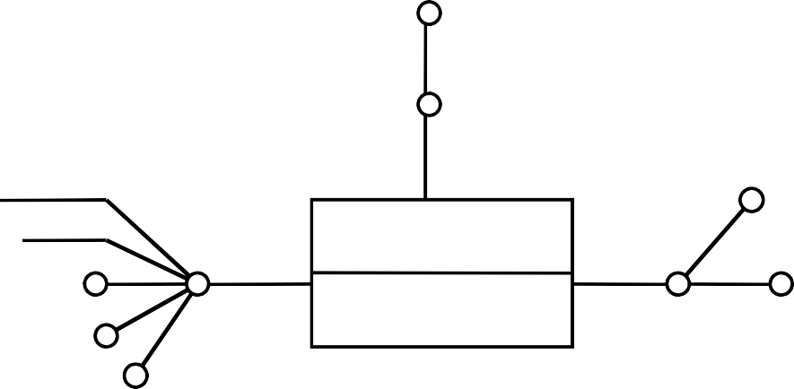
Factless fact schema
Some events are not characterized by measures
empty (i.e., factless) fact schema
it records occurrence of an event
Used for
counting occurred events (e.g., course attendance)
representing events not occurred (coverage set)
year
semester
address name
nationality
age
area
student
ATTENDANCE
course
(COUNT)
school

Slide 28
Representing time
Data modification over time is explicitly represented by event occurrences
time dimension
events stored as facts
Also dimensions may change over time
modifications are typically slower
slowly changing dimension [Kimball]
examples: client demographic data, product description
if required, dimension evolution should be explicitly modeled

Slide 29
How to represent time (type I)
Snapshot of the current value
data is overwritten with the current value
it overrides the past with the current situation
used when an explicit representation of the data change is not needed
example
customer Mario Rossi changes marital status after marriage
all his purchases correspond to the “married” customer

Slide 30
How to represent time (type II)
Events are related to the temporally corresponding dimension value
after each state change in a dimension
a new dimension instance is created
new events are related to the new dimension instance
events are partitioned after the changes in dimensional attributes
example
customer X, changes marital status after marriage
his purchases are partitioned in purchases performed by “unmarried” and purchases performed by “married” X

Slide 31
How to represent time (type III)
All events are mapped to a dimension value sampled at a given time
it requires the explicit management of dimension changes during time
the dimension schema is modified by introducing
two timestamps: validity start and validity end
a new attribute which allows identifying the sequence of modifications on a given instance (e.g., a “master” attribute pointing to the root instance)
each state change in the dimension requires the creation of a new instance

Slide 32
How to represent time (type III)
Example
customer X changes marital status after marriage
validity end timestamp of first X instance is given by the marriage date
validity start timestamp of the new instance is the same day
purchases are partitioned as in type II
a new attribute allows tracking all changes of instance X

Slide 33
Workload
Workload defined by
standard reports
approximate estimates discussed with users
Actual workload difficult to evaluate at design time
if the data warehouse succeeds, user and query number may grow
query type may vary over time
Data warehouse tuning
performed after system deployment
requires monitoring the actual system workload

Slide 34
Data volume
Estimation of the space required by the data mart
for data
for derived data (indices, materialized views)
To be considered
event cardinality for each fact
domain cardinality (number of distinct values) for hierarchy attributes
attribute length
It depends on the temporal span of data storage
Sparsity
occurred events are not all combinations of the dimension elements
example: the percentage of products actually sold in each shop and day is roughly 10% of all combinations

Slide 35
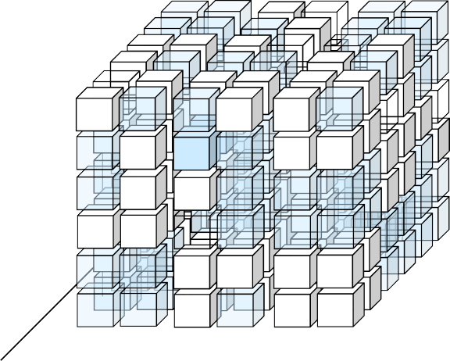
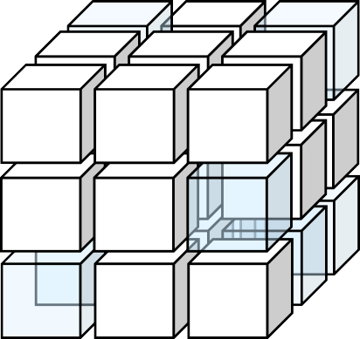
Sparsity
It decreases with increasing data aggregation level
May significantly affect the accuracy in estimating aggregated data cardinality

Slide 36
Logical design

Slide 37
Logical design
The relational model (ROLAP) in case you build a DWH around tabular data only.
A DFM model (conceptual model can be mapped) to many logical ones (i.e. relational, XML, ORM, etc.)
inputs
conceptual fact schema
workload
data volume
output
relational logical schema (if you have a relational data server)
Based on different principles with respect to traditional logical design
data redundancy
table denormalization

Slide 38
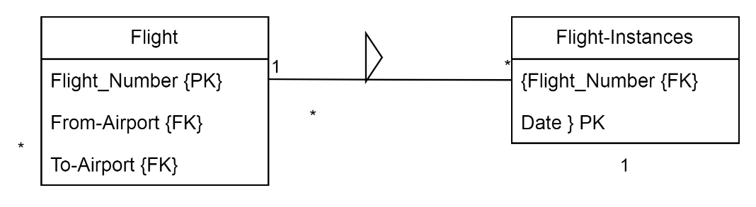
Tutorial 2 Review
FLIGHTS(flight-Number, airline, From-Airport: AIRPORTS, To-Airport: AIRPORTS, departure Time, arrivalTime, carrier)
FLIGHT_INSTANCES (Flight-Number: FLIGHTS, date)

Slide 39
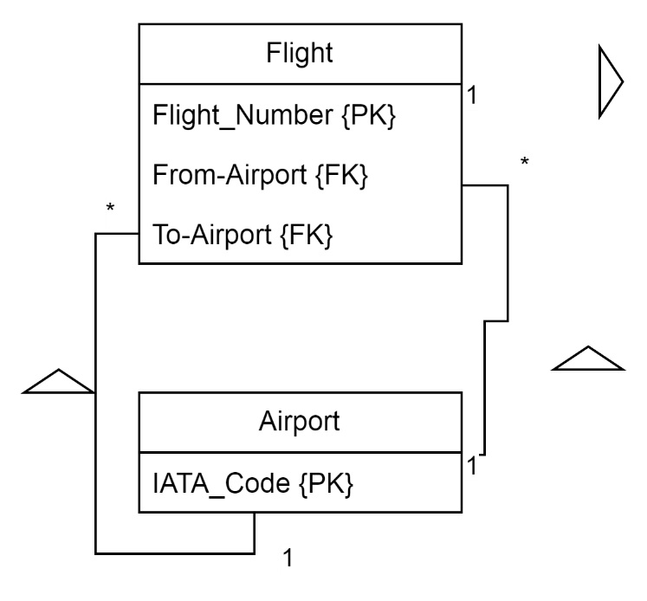
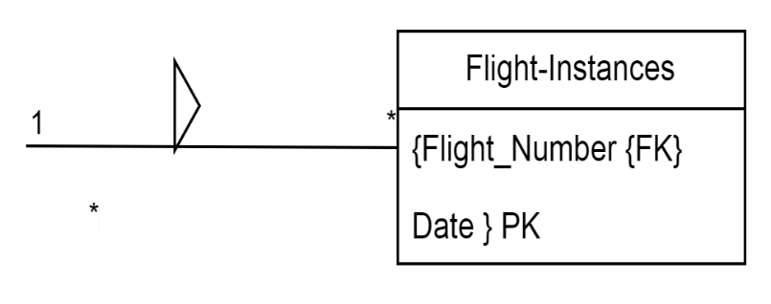
Tutorial 2 Review
FLIGHTS(flight-Number, airline, From-Airport: AIRPORTS, To-Airport: AIRPORTS, departure Time, arrivalTime, carrier)
FLIGHT_INSTANCES (Flight-Number: FLIGHTS, date)
AIRPORTS (IATA-Code, name, city, country)

Slide 40
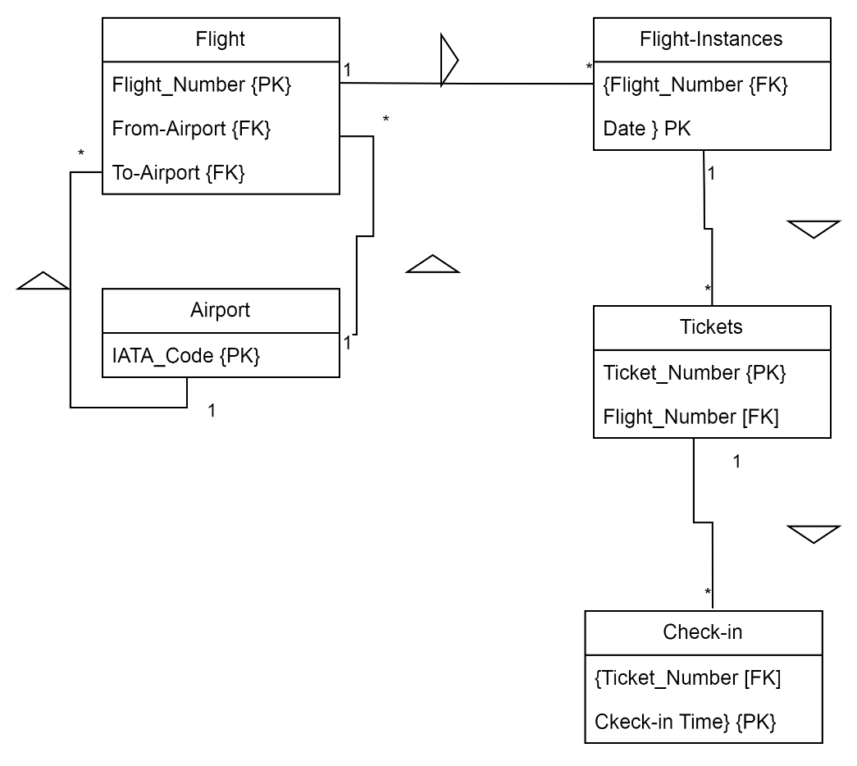
Tutorial 2 Review
FLIGHTS(flight-Number, airline, From-Airport: AIRPORTS, To-Airport: AIRPORTS, departure Time, arrivalTime, carrier)
FLIGHT_INSTANCES (Flight-Number: FLIGHTS, date)
AIRPORTS (IATA-Code, name, city, country)
TICKETS (Ticket-Number, FlightNumber: FLIGHT_INSTANCES, fare, passengersFirstName, passengersSurname, passengersGender)
CHECK-IN (Ticket-Number: TICKETS, Check-in-Time, Seat, numberOfBags)

Slide 41
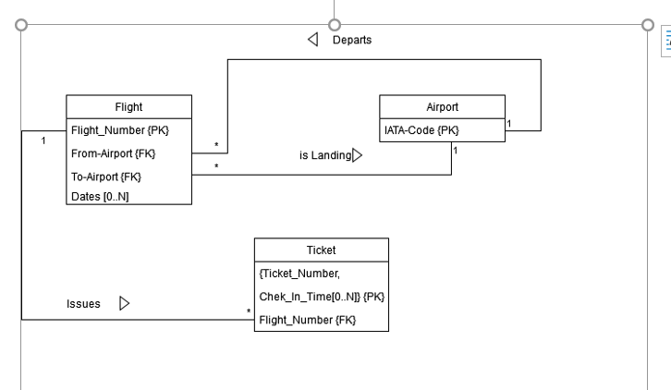
=
Tutorial 2 Revie
EQUIVALENT DESIGNS/MODELS

